Slide 1

MOBILE DEVELOPMENT with the ABP Framework

Slide 2
Last & Next ABP Releases

Slide 3

ABP v7.3 Final
Released at July 12, 2023.
Blog Post (shortened) URL: https://abp.io/b/v73
Volo.Abp.Imaging.* Packages to manipulate (resize & compress) images
Nonce attribute support for Content Security Policy (CSP)
Monitoring distributed events in-process
Ordering execution of local event handlers
Many enhancements & bug fixes (700+ commits)

Slide 4
ABP v7.4 RC
Planned Release Date: August 15, 2023
ABP Framework
Dynamic setting store
Adding CorrelationId to distributed events
Do not expose integration services / controllers by default
ABP Commercial
Mobile Application
Revise the mobile application (React Native & MAUI) functionality and UI design
ABP Suite
Keep customized code on re-generation for CRUD page generation
Master/Detail entity support for CRUD code generation*
Modules:
Account/Identity: Password complexity indicator
Chat: Delete messages/converstations
Text Template Management: Support distributed systems for text template customizations

Slide 5
ABP v8.0 RC
Planned Release Date: November 15, 2023.
Based on .NET 8.0

Slide 6
ABP Community News

Slide 7
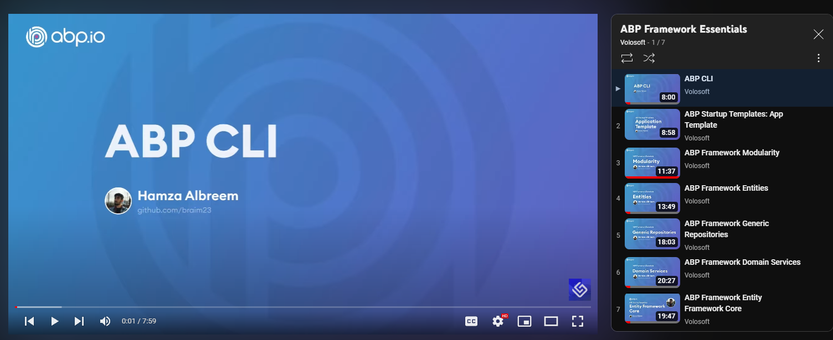
Video Series: ABP Framework Essentials 7 videos / 100 minutes of content
https://www.youtube.com/@Volosoft

Slide 8
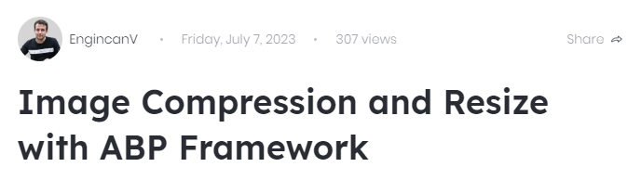
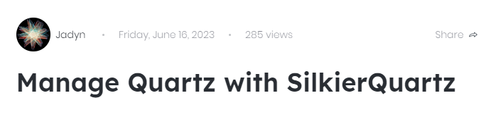
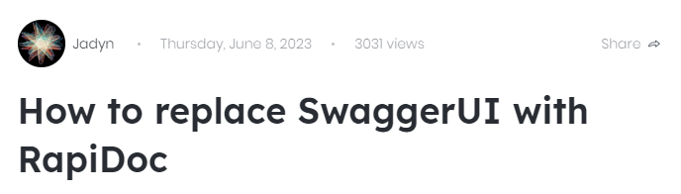
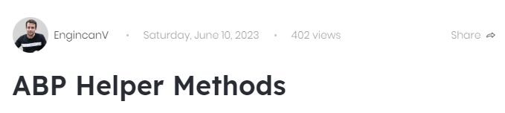
Latest Posts https://community.abp.io

Slide 9
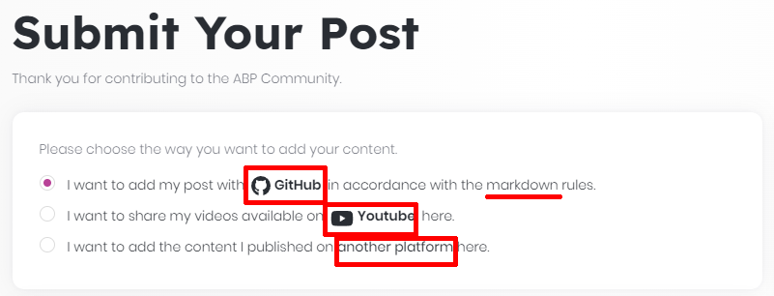
ABP Community Stats
163 Text Articles
96 Video Posts
By XXX Authors
In 3 Languages (English, Chinese, Turkish)
https://community.abp.io/posts/submit

Slide 10
Topic title
Content

Slide 11
Topic title
Content

Slide 12
Topic title
Content

Slide 13
Topic title
Content

Slide 14
Topic title
Content

Slide 15
Topic title
Content

Slide 16
Topic title
Content

Slide 17
Topic title
Content

